Slide 1
HOME LOAN PREDICTION
-STANDARD BANK
Team Name: Biryani Bandits
Team members:
Nikhil Shenoy, Ashutosh Misra, Sohaib Ahmed, Nikkhil Matthew

Slide 2
RECAP

Slide 3

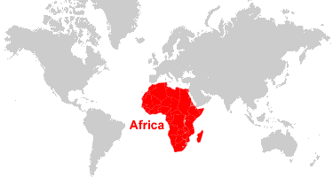
About our client
Standard Bank Group is Africa’s largest bank, with a 160-year track record of operational excellence and value.
As a financial services provider transforming into a platform business, the Standard Bank Group has been creating a co-ordinated network of participants and devices to meet clients’ needs wherever they are.

Slide 4

Problem Statement
Standard Bank is embracing the digital transformation wave and intends to use new and exciting technologies to give their customers a complete set of services from the convenience of their mobile devices.
The current process involves loan officers having to manually process home loan applications. This process takes 2 to 3 days to process, upon which the applicant will receive communication on whether or not they have been granted the loan for the requested amount.
To improve the process, Standard Bank wants to make use of machine learning to assess the creditworthiness of an applicant by implementing a model that will predict if the potential borrower will default on his/her loan or not, and do this such that they receive a response immediately after completing their application.

Slide 5
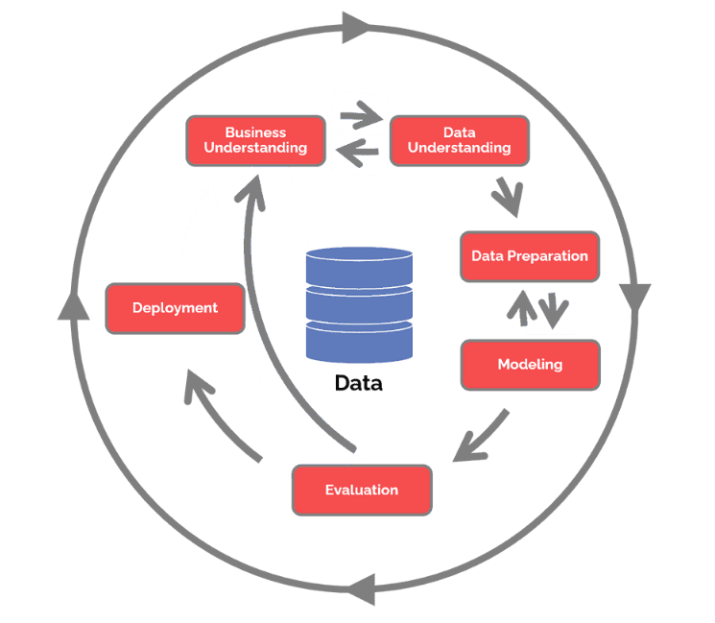
OUR APPROACH AND PROJECT LIFECYCLE
We will be using CRISP-DM as our approach:
The CRoss Industry Standard Process for Data Mining (CRISP-DM) is a process model that serves as the base for our data science project. It has 6 phases:
Business understanding – Understanding of the data as it has all the columns for the prediction required.
Data understanding/preparation – 10000 rows and 13 columns, data with various predictors, after cleaning.encoding of various target variables to achieve the desired output null values and zero values with same number of columns.
Modeling – Logistic regression, Decision tree and random forest.
Evaluation – Random Forest seems like the most accurate model
Deployment – stakeholders can access the prototype of the front end which works on the trained,tested data through the front end available.

Slide 6







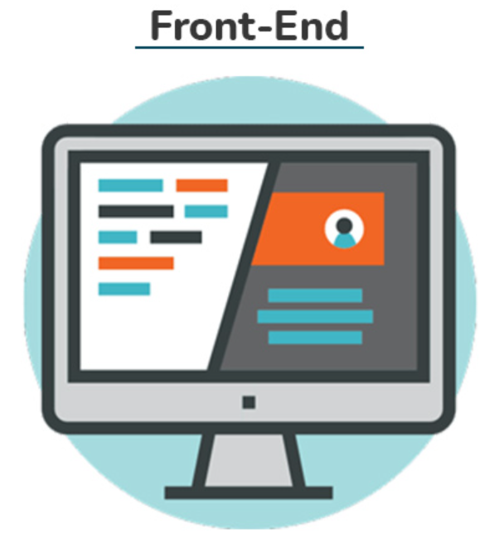
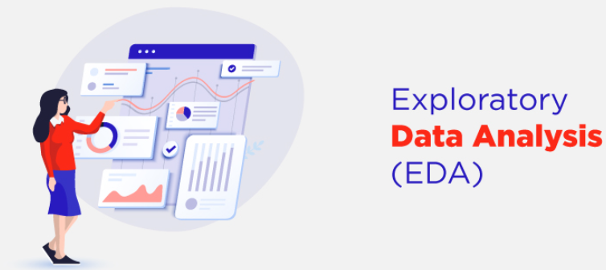

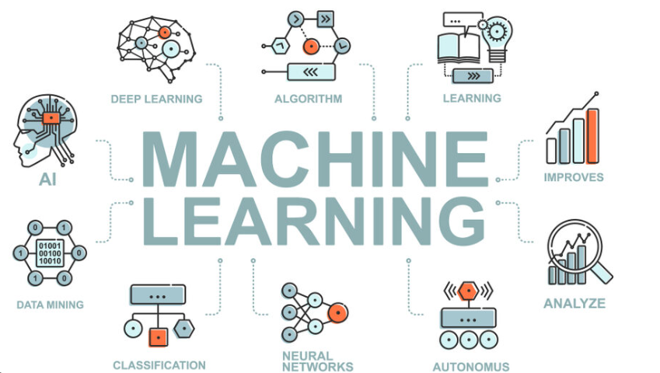

ARCHITECTURE
Future

Slide 7
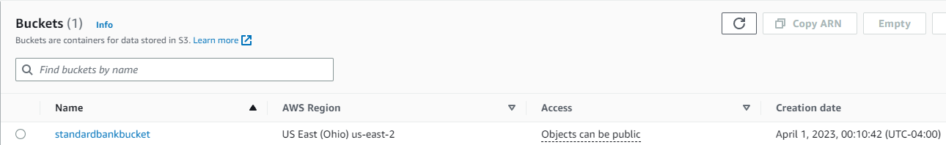
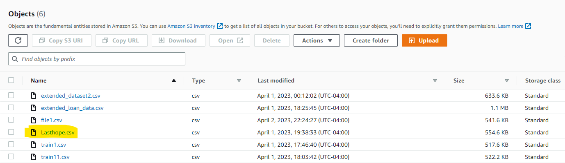
Our S3 Bucket
Our File

Slide 8
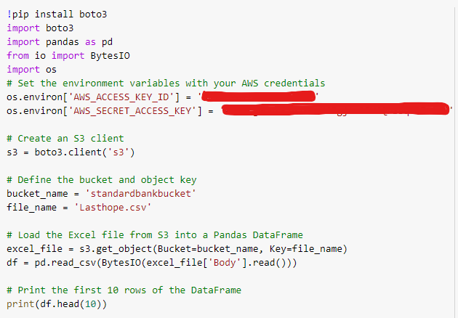
Integration with Boto

Slide 9


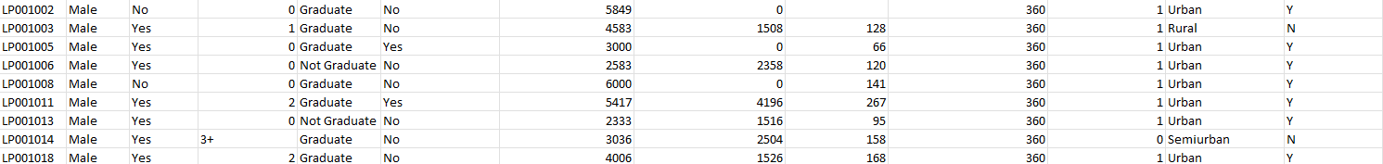
Source and Structure:
The Home Loans Department has handed us sample data and they want to see a prototype. Also wants to know whether to add/subtract some attributes.
The below is the shape of the data
Attributes
Records

Slide 10
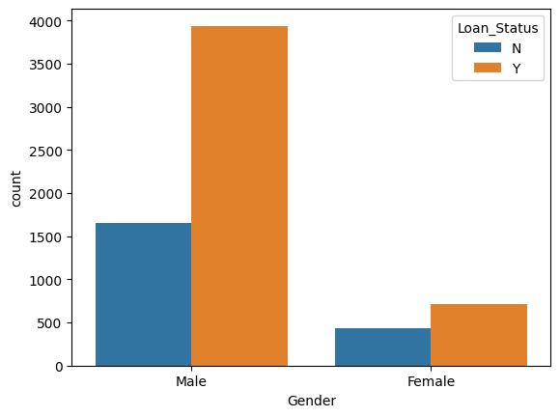
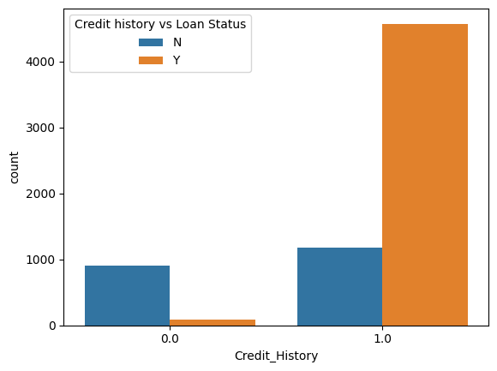
Exploratory Data Analysis
sns.countplot(x='Credit_History', hue='Loan_Status', data=df)
plt.legend(title='Credit history vs Loan Status')
plt.show()
sns.countplot(x='Gender', hue='Loan_Status', data=df)
plt.legend(title='Loan_Status')
plt.show()

Slide 11
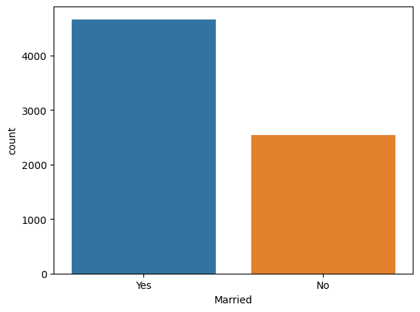
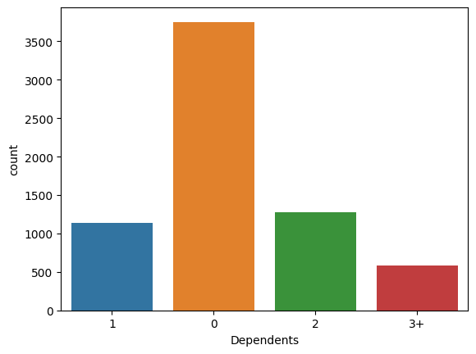
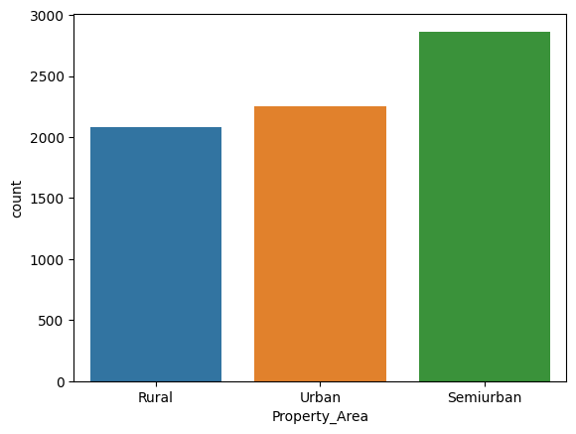
Exploratory Data Analysis

Slide 12
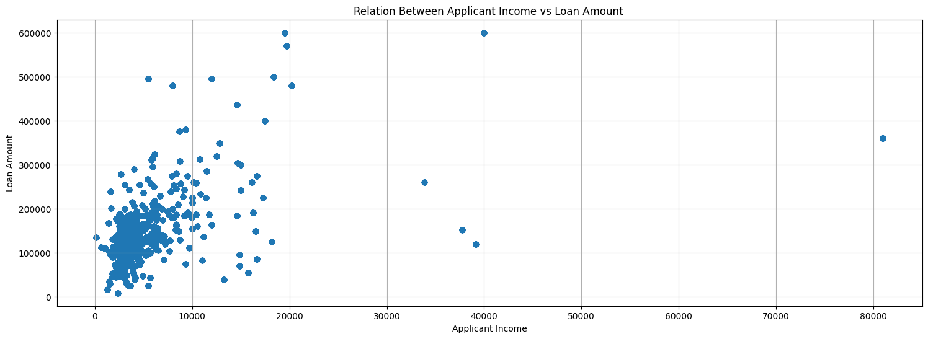
plt.figure(figsize=(18, 6))
plt.title("Relation Between Applicant Income vs Loan Amount ")
plt.grid()
plt.scatter(df['ApplicantIncome'] , df['LoanAmount'])
plt.xlabel("Applicant Income")
plt.ylabel("Loan Amount")
plt.show()

Slide 13
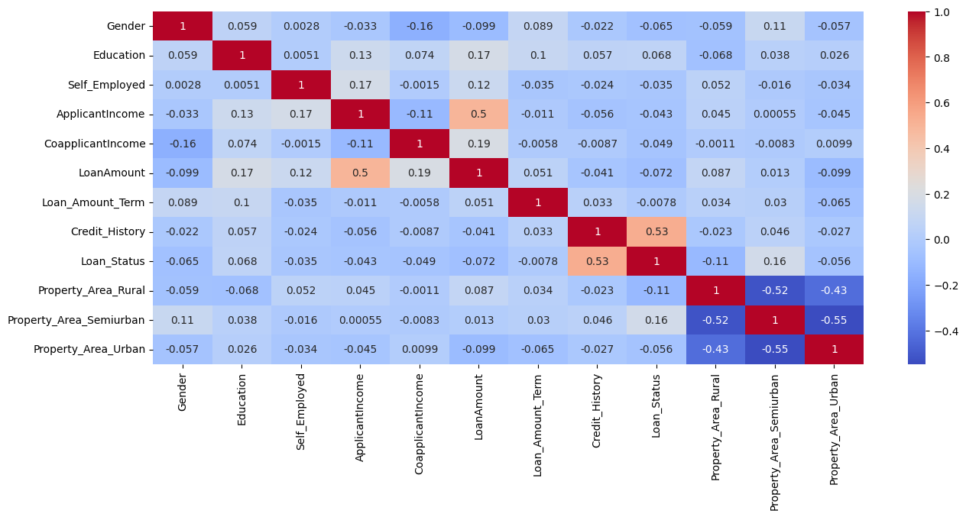

Slide 14
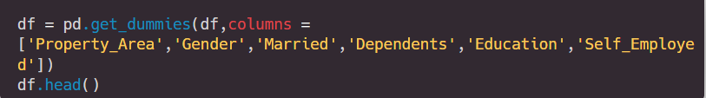
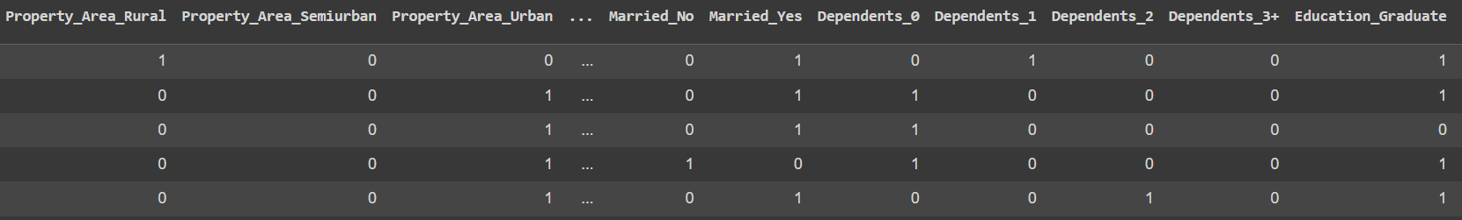
One hot encoding to convert categorical variables

Slide 15
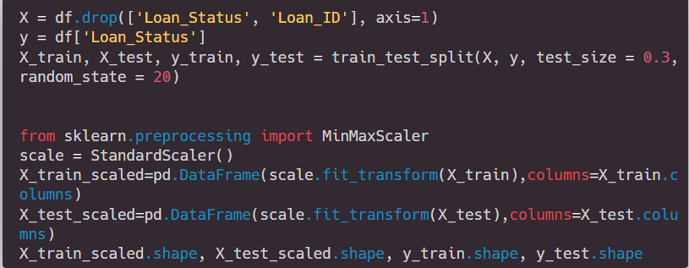
Test and Train

Slide 16
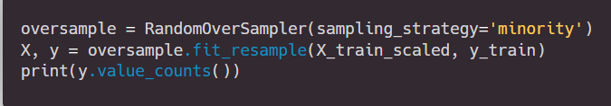
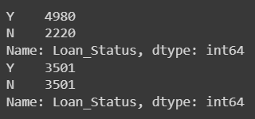
Oversampling to balance data

Slide 17
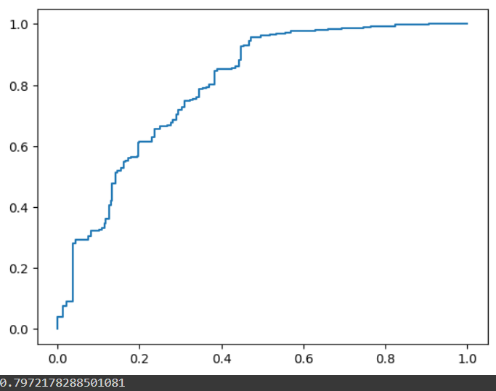
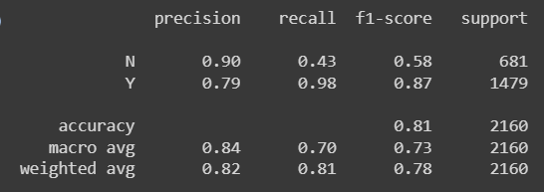
Logistic Regression

Slide 18
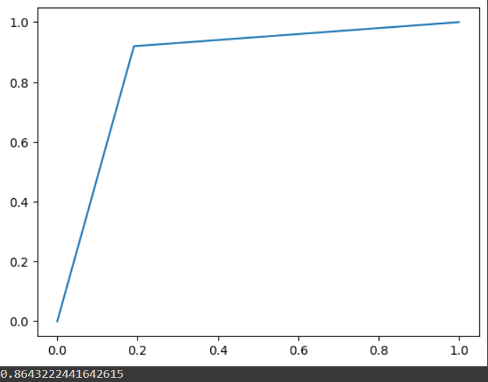
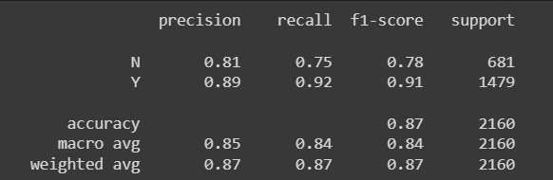
Decision Tree Classifier

Slide 19
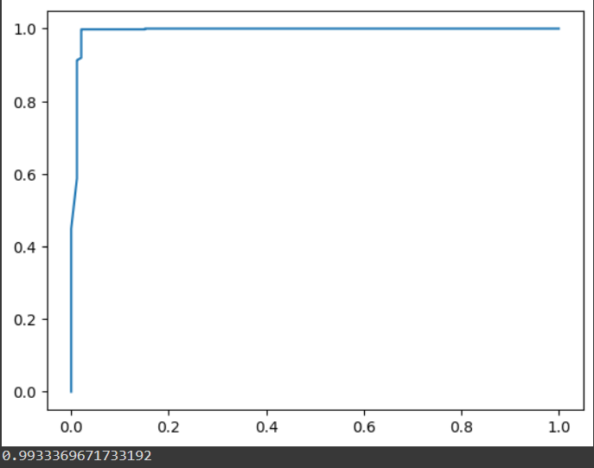
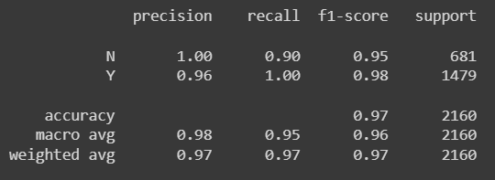
Random Forest

Slide 20
Model Comparisons
Model | Accuracy | ROC AUC
Logistic Regression | 81% | 0.79
Decision Tree | 87% | 0.86
Random Forest | 97% | 0.99

Slide 21
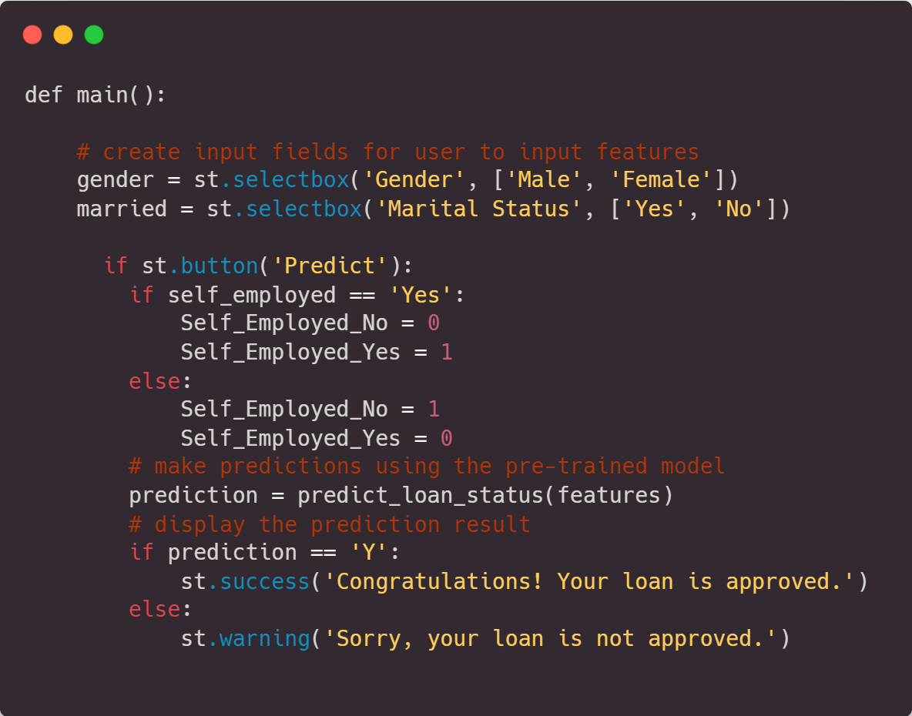
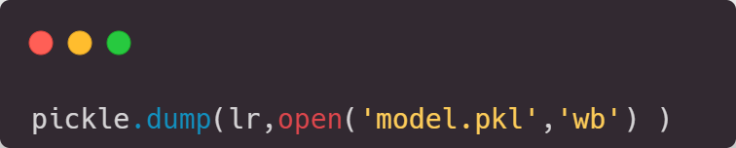
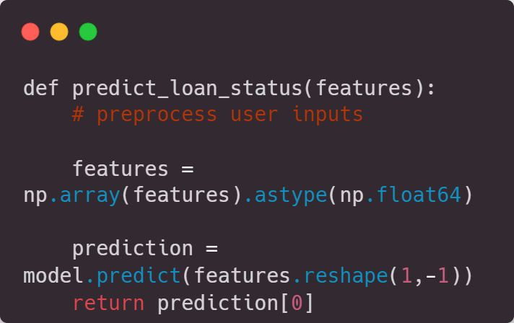
Front End

Slide 22
THANK YOU!
References:
All images -> google images
CRISP DM: https://www.datascience-pm.com/crisp-dm-2/

